Slide 1

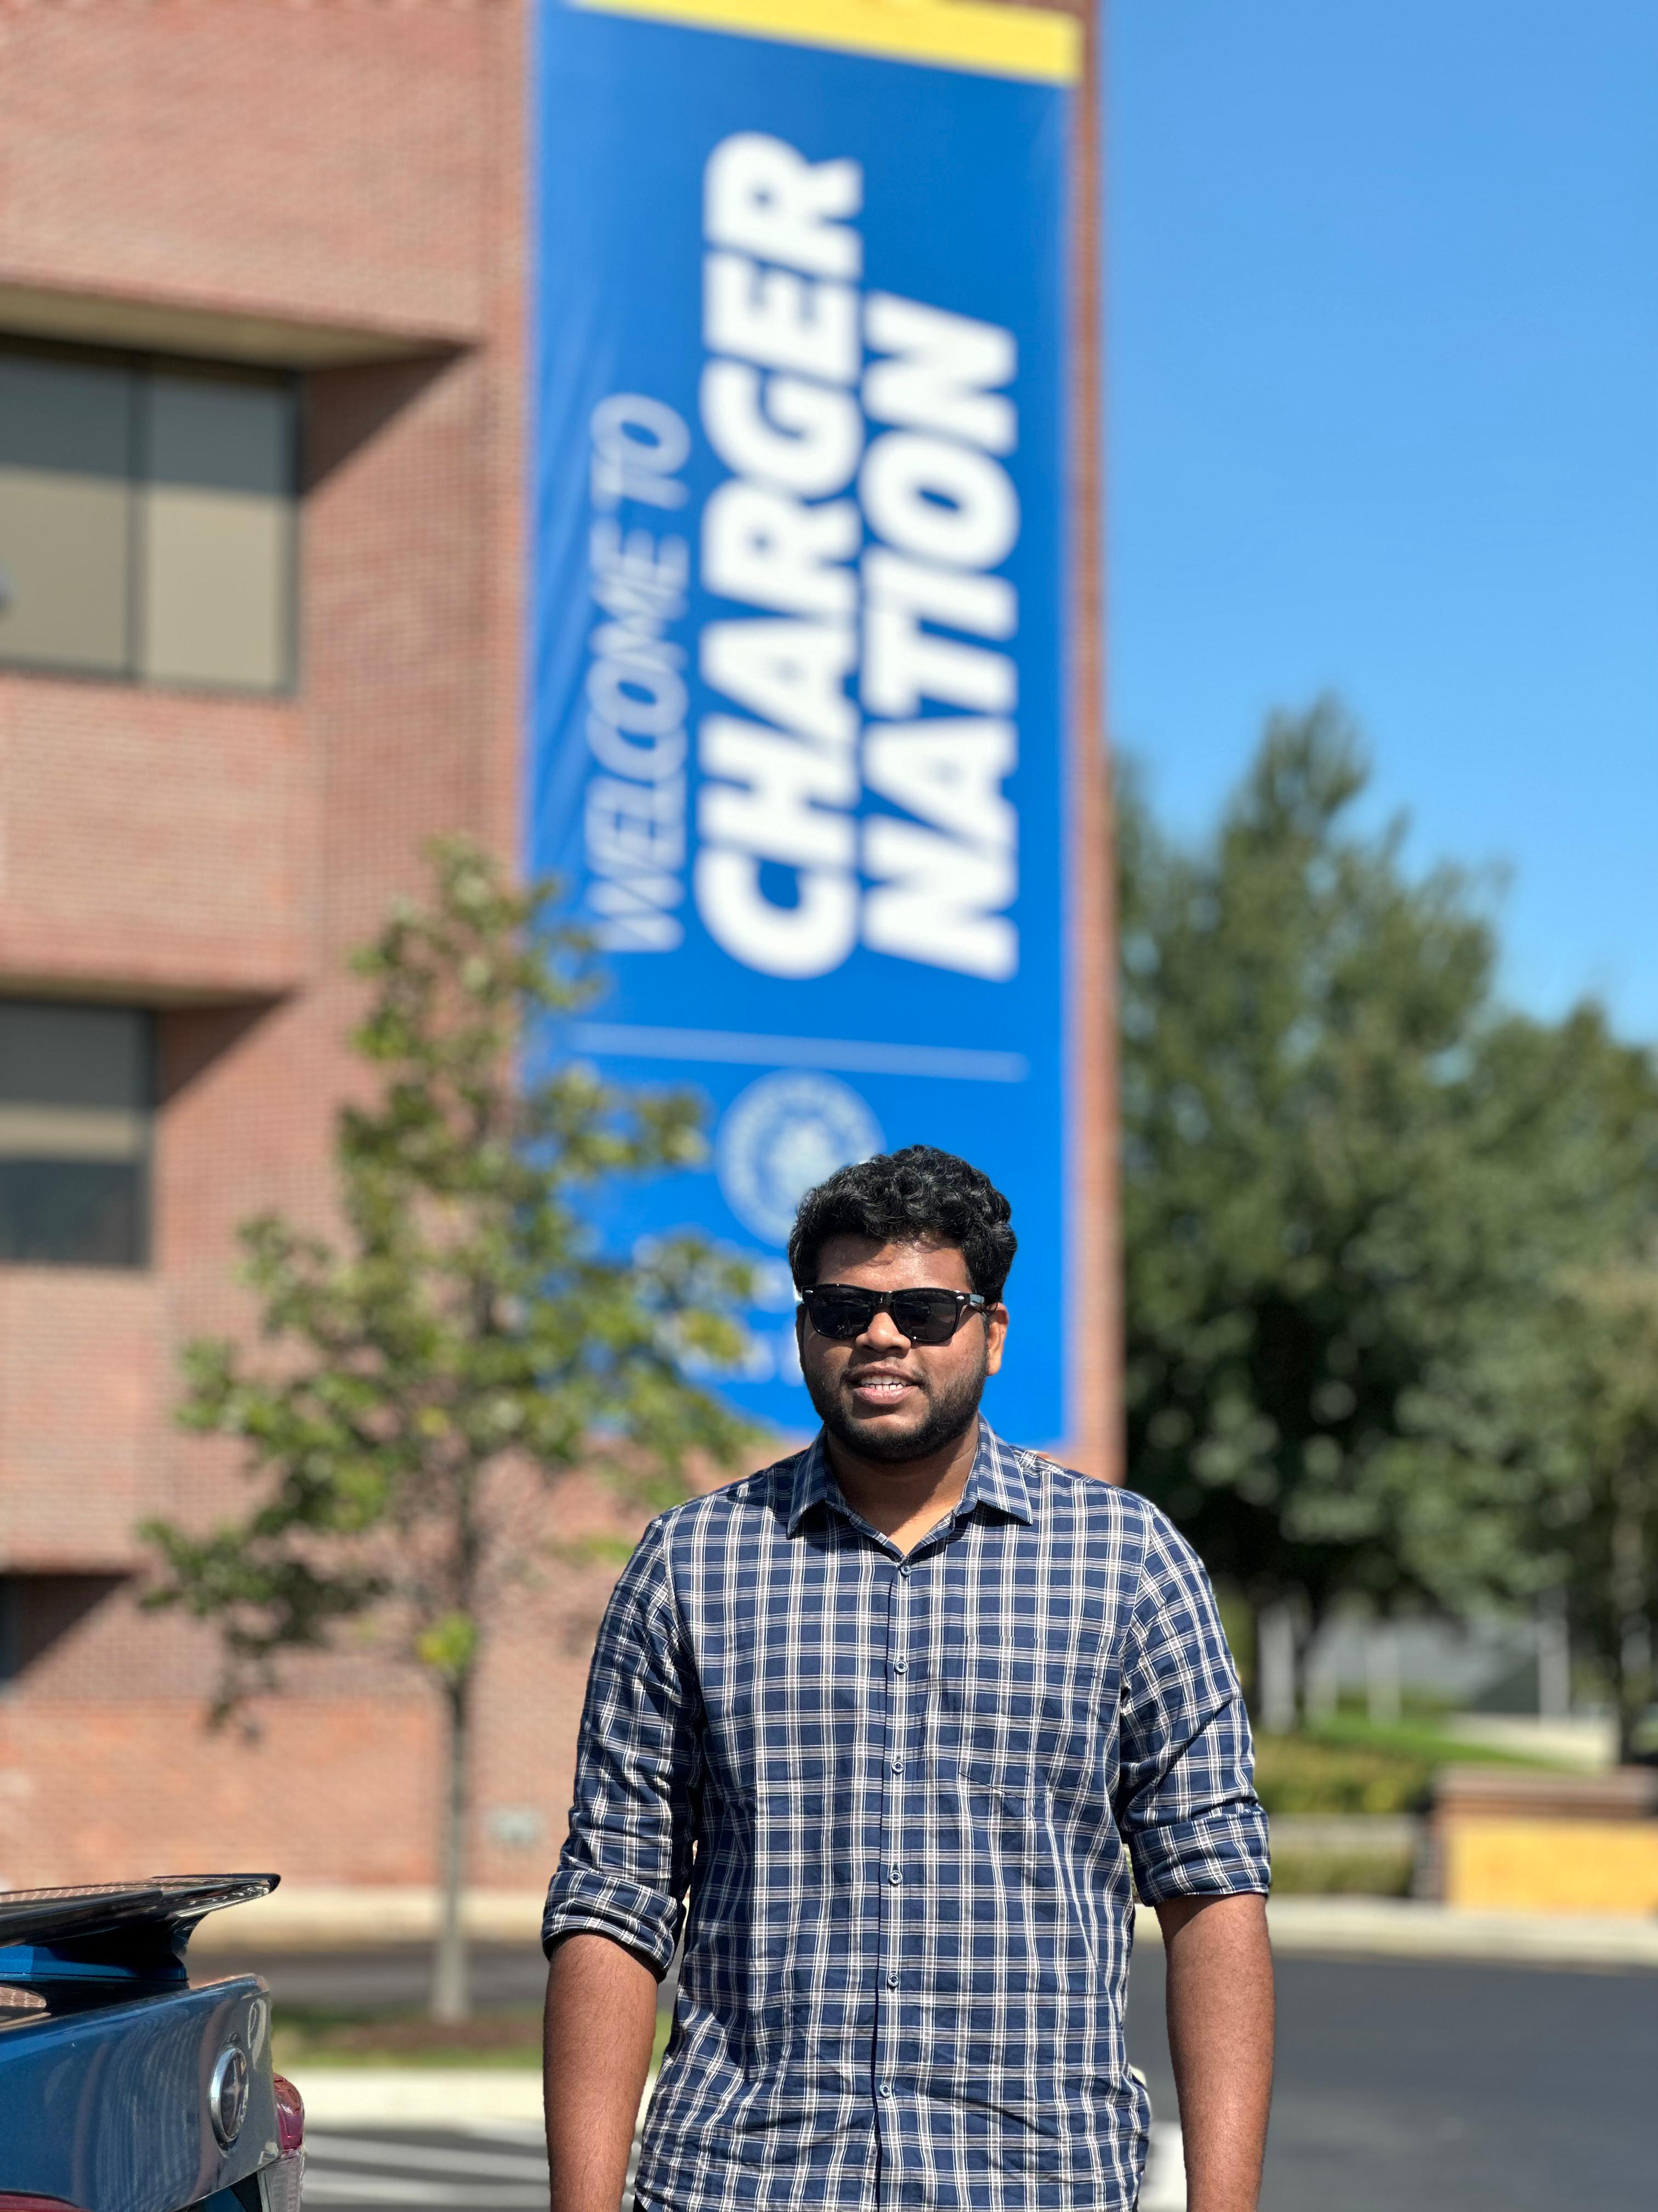

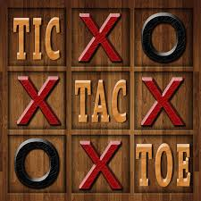
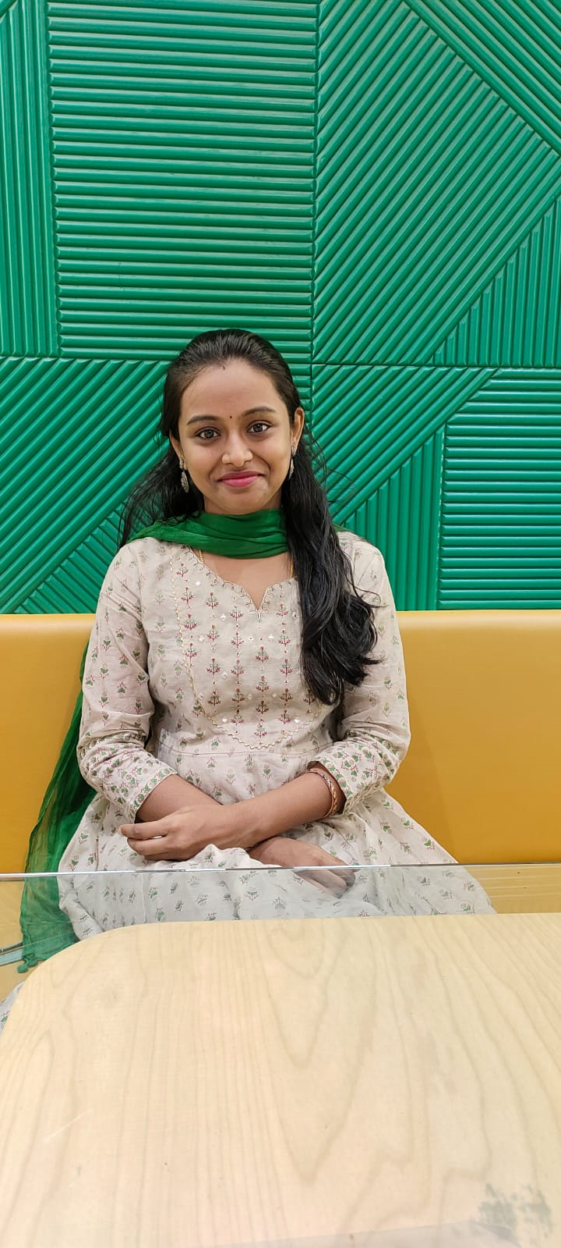

Peesapati Krishnaveni 00866275
Kanakanala Sujith
00837586

Slide 2
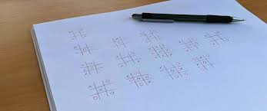
Implementation of Multiple Tic-Tac-Toe Agents in a Tournament Setting

Slide 3
Statement of project objectives:
The project aims to develop multiple AI agents that can play Tic-Tac-Toe against each other in a tournament. The agents will be designed to perform well and will be evaluated based on their performance.
The project also aims to test new algorithms, engage in educational activities related to AI and game playing, optimize the parameters of the agents, and gain a better understanding of the best strategies for playing the game.

Slide 4


Approach
Programming Language : Python.
Algorithms:
Minimax algorithm using traditional approach and alpha-beta pruning.
Expectimax algorithm
Q-Learning

Slide 5

Deliverables
Power Point presentation(PPT)
YouTube video
Documentation report
Program file(.py files)

Slide 6
Evaluation methodology
The success of the Tic-Tac-Toe tournament hinges on developing four AI agents using diverse, effective algorithms.
These initial agents must undergo rigorous training to achieve intuitive, fluid decision-making that accurately mimics human-level performance in the game.
Stability is paramount; agents should not experience freezing or processing delays during live matches that disrupt seamless gameplay flow. This ensures the tournament can evaluate innovations while maintaining credibility and engagement.

Slide 7



